Slide 1
Task 1 EDA
By. Mohamed Elshamy

Slide 2
Introduction
This is a data for a hotel That shows us the Booking if its canceled or not

Slide 3
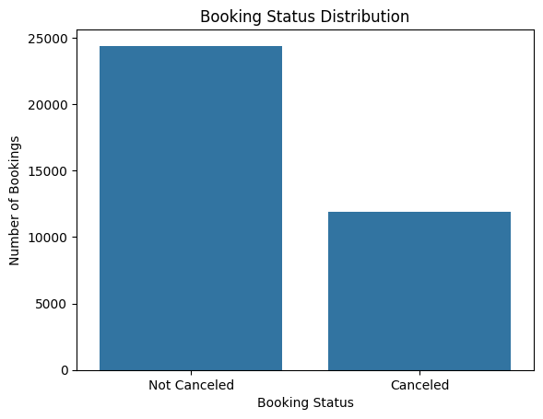
From this graph We can see that most of the booking are not canceled

Slide 4
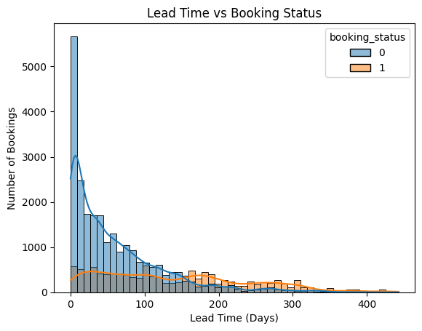
This distribution clearly shows how cancellation likelihood escalates as booking windows extend

Slide 5

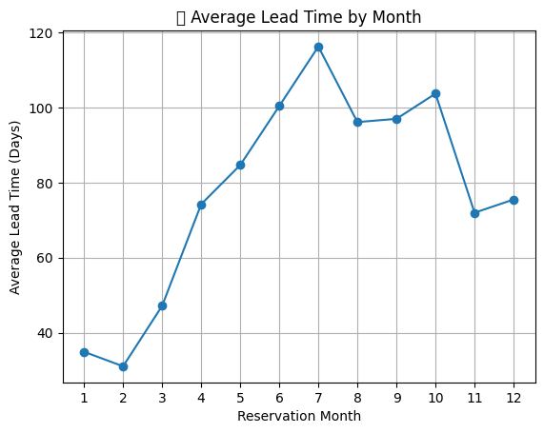
People Tends to Book with a long lead time mostly in the middle of the year.

Slide 6
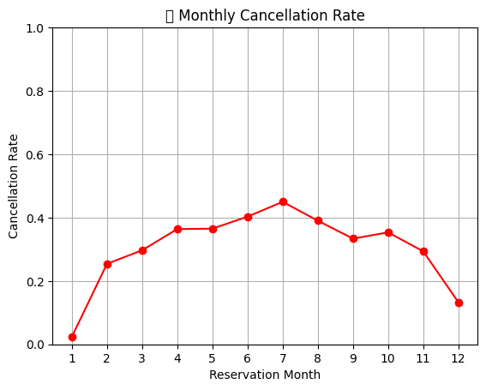
Also, The cancelation rate peak tends to get higher until reaching the peak in the middle of the year then get lower again.

Slide 7
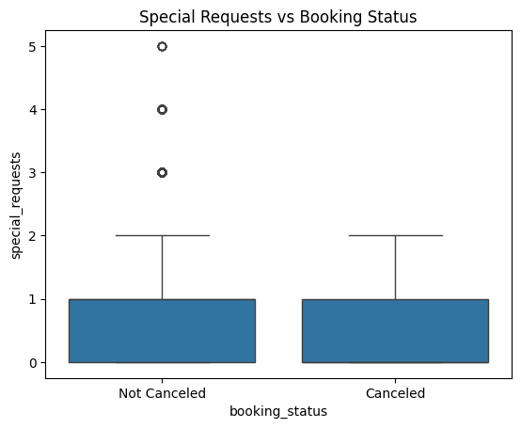
The guests with Special requests less likely to cancel their bookings.

Slide 8
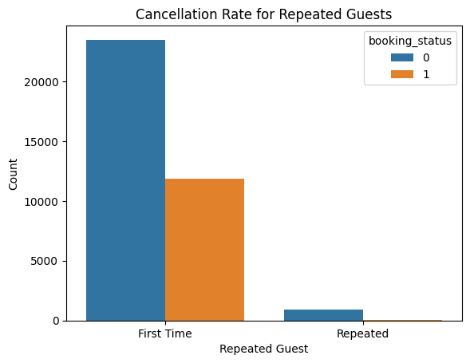
While the repeated guests are less likely to cancel their bookings.

Slide 9
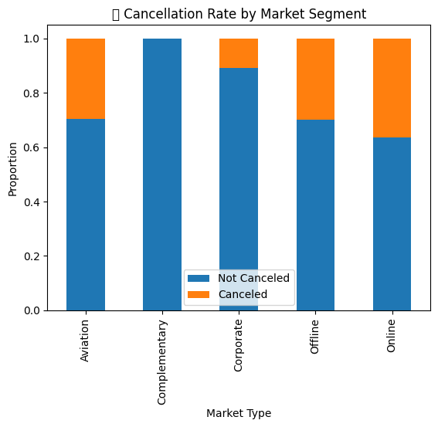
The cancelation rate is high in online , Offline and Aviation markets.
While the cancelation rate is low in the Complementary and Corporate markets.

Slide 10
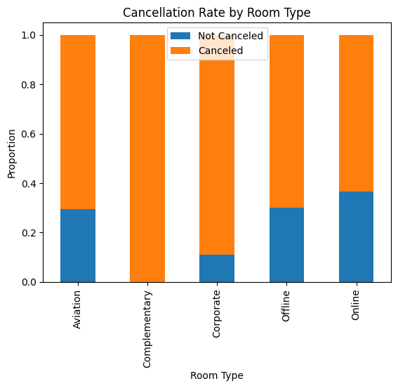
The cancelation rate is mostly high in the Room type.

Slide 11
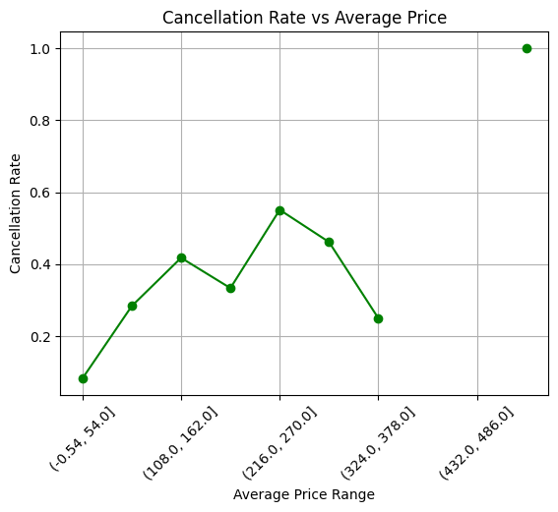
The average price seems to have some relationship with the cancellation rate, although it might not be a simple linear relationship.

Slide 12
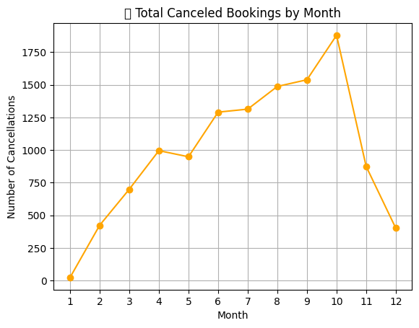
The total number of cancellations also shows a seasonal pattern, aligning with the monthly cancellation rate.

Slide 13
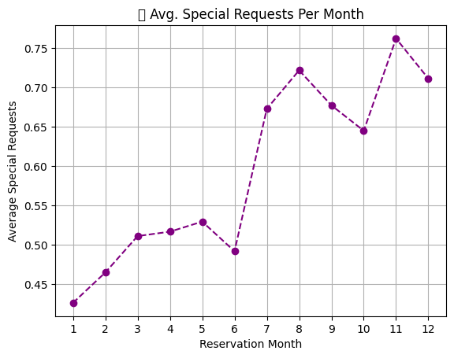
The average number of special requests also varies by month. In which its increased gradually till the end of the year.

Slide 14
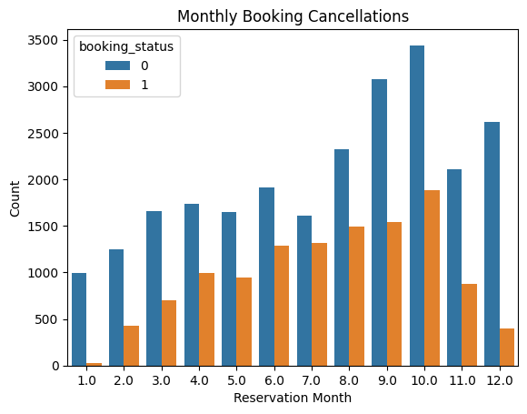
This plot clearly shows the monthly distribution of both canceled and not-canceled bookings, highlighting the months with higher booking activity and cancellations.

Slide 15
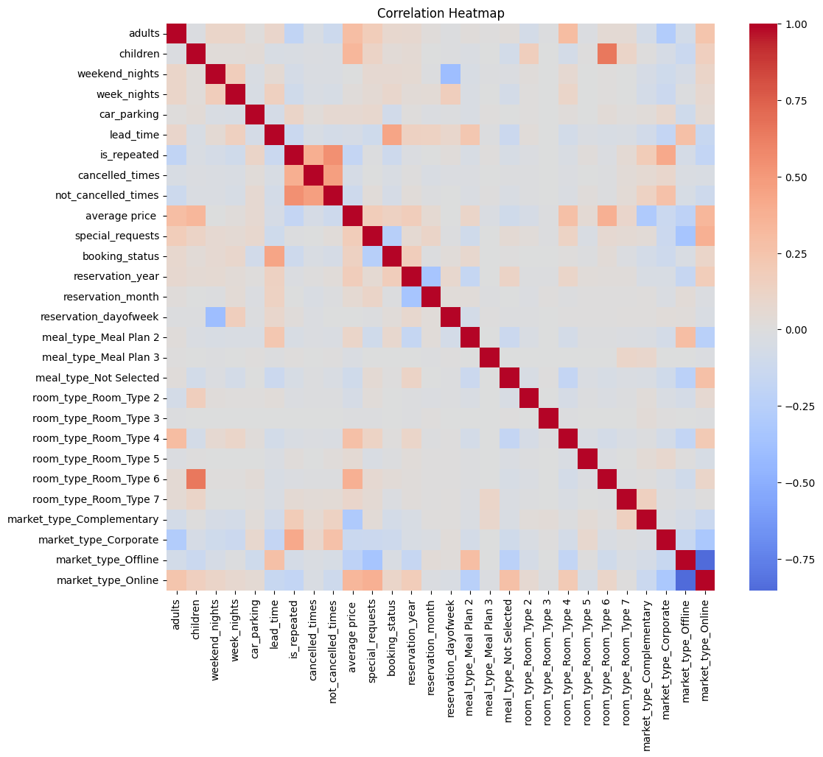
The correlation heatmap reveals how numerical features relate to cancellations and helps detect multicollinearity between features.

